Slide 1
SIMPLIFYING THE BRAIN: A Vision for Neuroscience Research
V. Srinivasa Chakravarthy
Department of Biotechnology
IIT Madras.

Slide 2


“The number of neurons in the Brain are…
more than the number of stars in the Milkyway Galaxy.”

Slide 3


“The Brain is the most COMPLEX object in the Universe.”

Slide 4
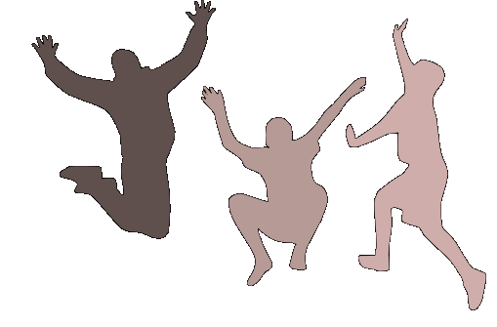
Why the HYPE?

Slide 5



1. Large Projects

Slide 6
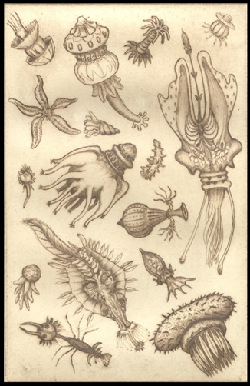
2. Descriptive tradition of Biology
Antoine von
Leeuwenhoek’s
Drawings of
“animalcules”

Slide 7

Can a biologist fix a radio?
Yuri Lazebnik, Can a biologist fix a radio?—Or, what I learned while studying apoptosis
Cancer Cell, 2012.

Slide 8
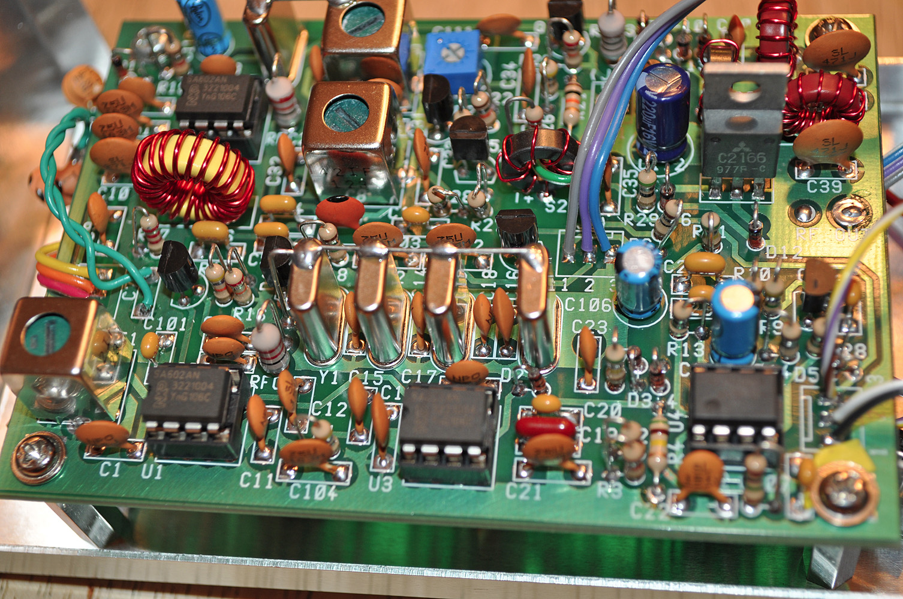

Slide 9

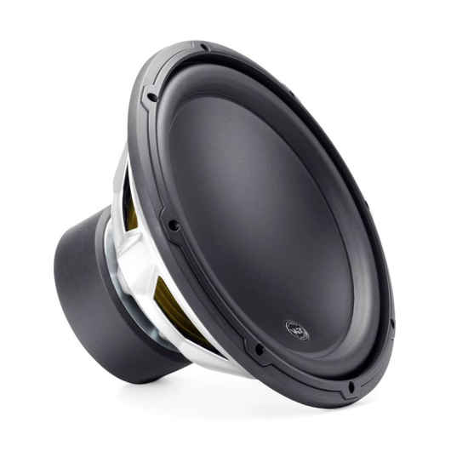
Architecture of a Radio
Tuner
Circuit
Demodulator
Amplifier
Antenna
Speaker

Slide 10

3. Big data …

Slide 11
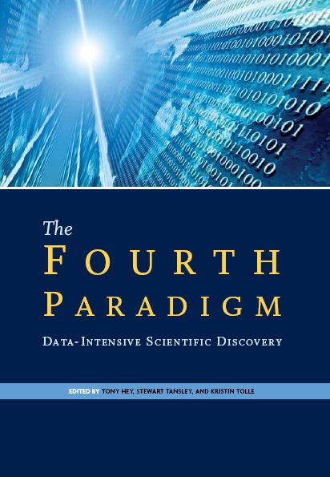
DATA in modern world
Data as the fourth pillar of science
The first 3 pillars are:
Theory
Experiment
Computation

Slide 12
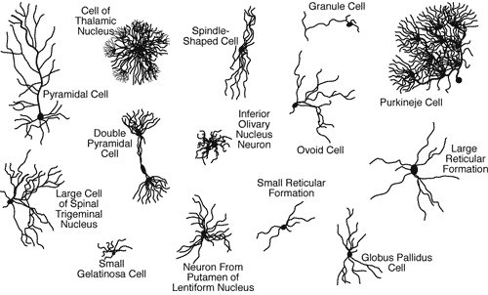
Neurons come in different Shapes

Slide 13
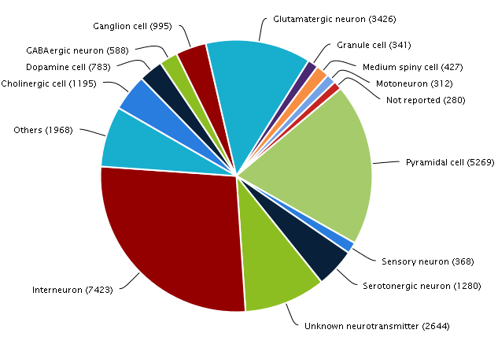
Neuromorph

Slide 14
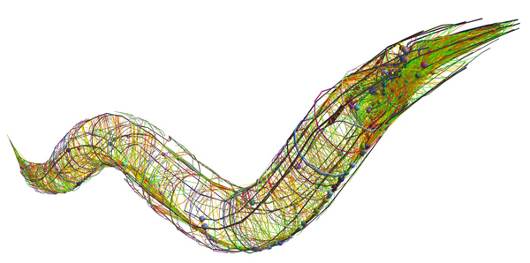
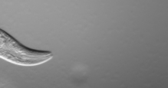
The Connectome Project
To find out the complete wiring diagram of the brain
Human brain
Has 100 billion neurons
Each neuron has about 1k-10k connections
Feasible for smaller organisms
C. Elegans connectome – 300 neurons, 7000 connections (White et al 1986)

Slide 15
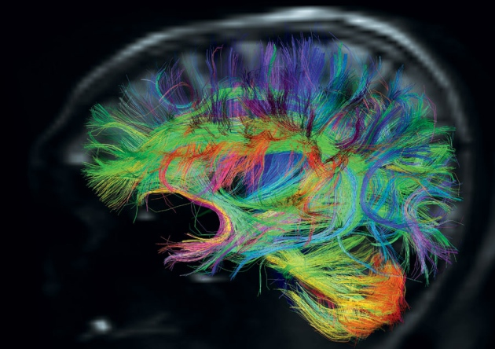
Human Connectome Project
- 1200 individuals
- fMRI + dMRI +
+ MRI + MEG
Washington U +
U. Minnesota
http://www.humanconnectome.org/

Slide 16
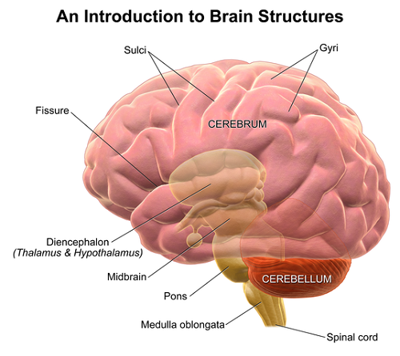
Why Connectome?
We don’t even know why:
There are two cerebral hemispheres?
There is a cortex?
Why the cerebellum is outside and thalamus inside?
What is the hurry
for the Connectome?

Slide 17
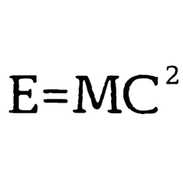
4. Big data …and tiny theory

Slide 18
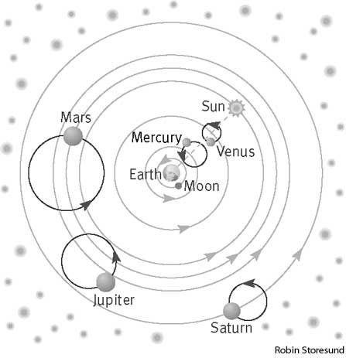
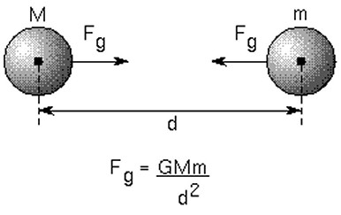
Analogy from the History of Astronomy
Ptolemaic Astronomy
Newtonian Astronomy

Slide 19
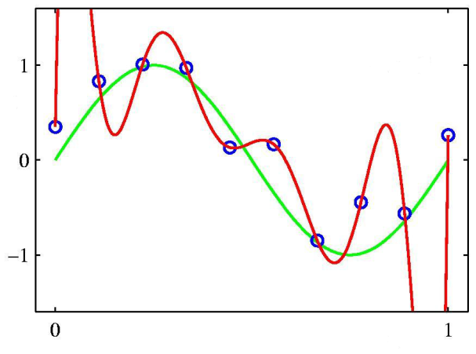
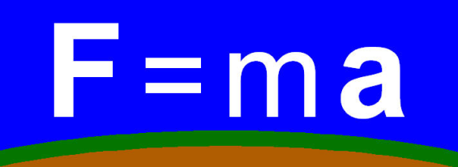
The Problem with Computational Modeling
More biology-style modeling
A thin wrapper over data
Less physics-style modeling
Need deep integrative theories
that relate diverse phenomena

Slide 20
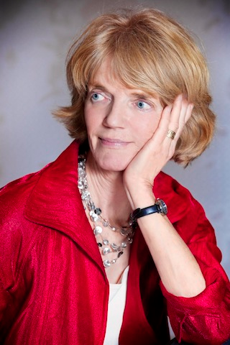

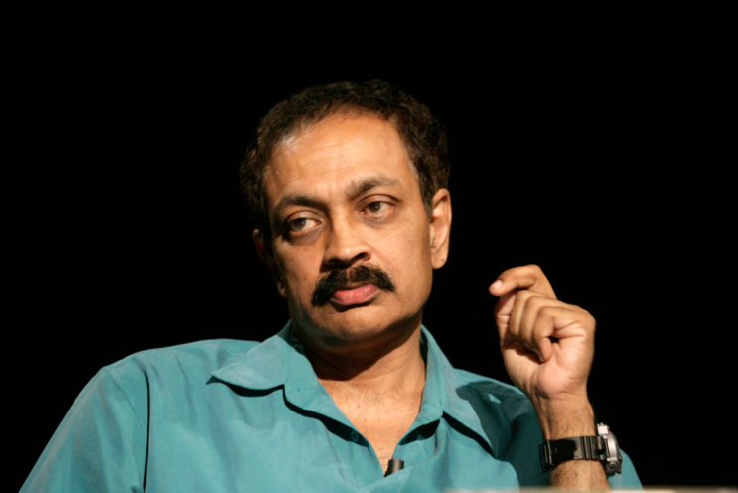
Neuroscience is … theory weak
No satisfactory, comprehensive theory for most key brain structures
Verbal, hand-waving theories.
Thalamus is a relay station
Basal ganglia is a comparator
Neuroscience is… “data rich but theory poor.”
“We are at Faraday stage in neuroscience.”
VS Ramachandran
(Neuroscientist)
Patricia Churchland
(Neuroscientist)
Terry Sejnowski
(Neuroscientist)

Slide 21

4. The Problem of Reductionism
Systems
Neurons
Molecules
The futile attempt to explain everything in terms of molecules and cells.

Slide 22
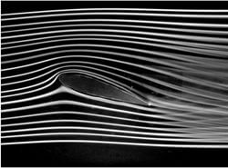
Engineering doesn’t work that way
Example:
Aircraft wing in a wind tunnel
Study fluid flow using Navier-Stokes Equation
FLUID is an abstraction
FLUID is NOT molecules

Slide 23
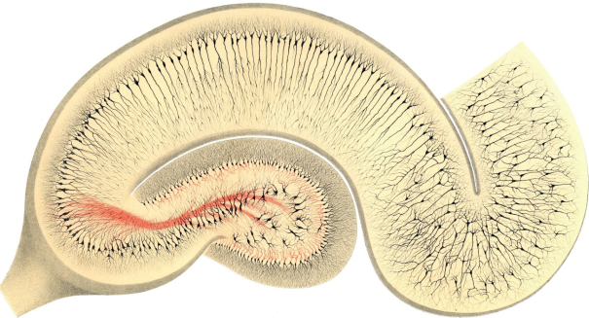
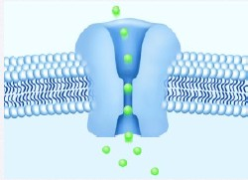
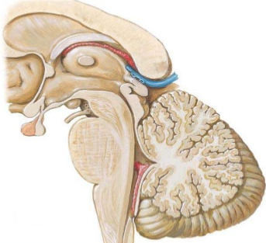
And therefore there is… Disproportionate Development
Rigorous understanding at
cell and molecular level
Inadequate understanding at
Systems Level

Slide 24

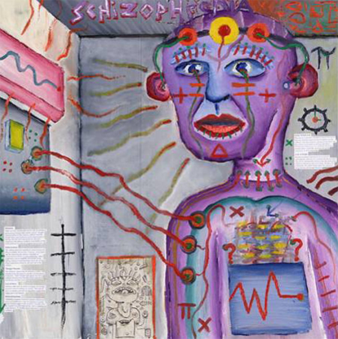
Lack of good theories of Multifactorial Diseases
Bipolar disorder
Schizophrenia

Slide 25


Contemporary Neuroscience
Basic Neuroscience
Clinical Neuroscience

Slide 26

There is a need to develop simplified models, embodying the right abstraction, the way it is done in physics and engineering

Slide 27
NEUROSCIENCE EDUCATION

Slide 28

“Principles first” Approach
PRINCIPLES
DETAILS
DETAILS
DETAILS

Slide 29
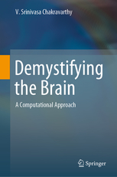

Slide 30
To
Medicine/Biology
Community.
Without math
To
Engineers/
Physicists
Without
Biology jargon

Slide 31
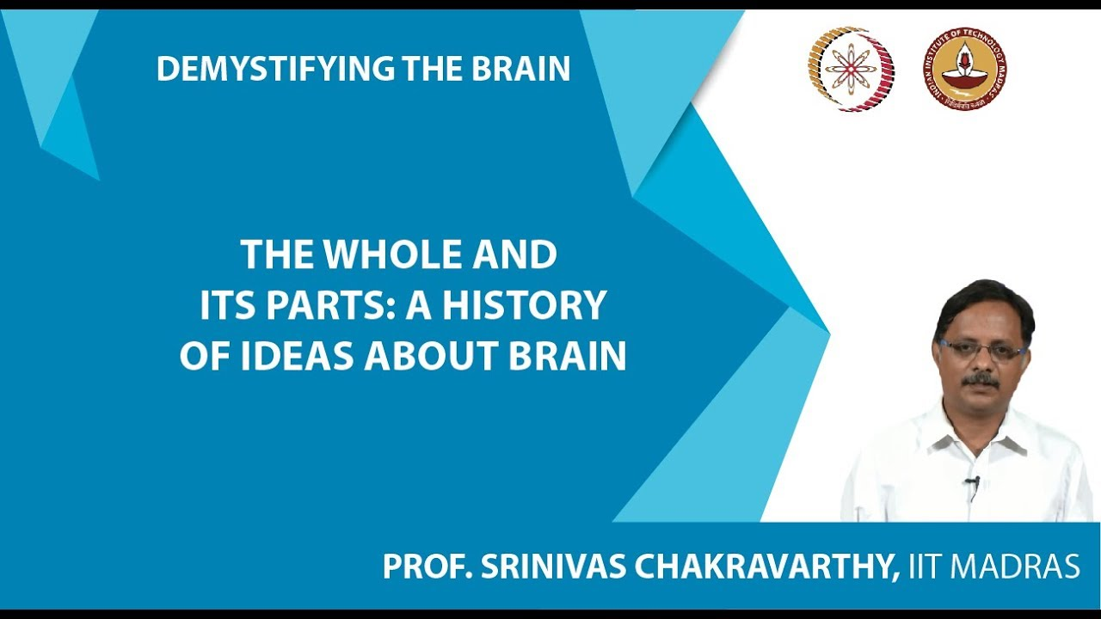
NPTEL COURSE DEMYSTIFYING THE BRAIN

Slide 32
AN APPROACH TO BRAIN modelLiNG
NEUROSCIENCE RESEARCH
SIMPLIFY - UNIFY - APPLY

Slide 33
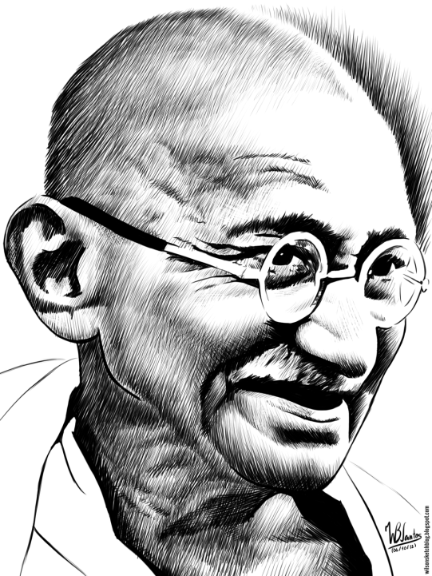

SIMPLIFY: Simplify the model to the point that any further
simplification will make the model absurd.

Slide 34




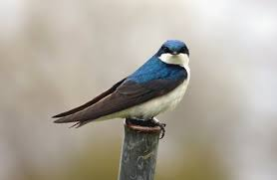
2. UNIFY: Explain a wide range of experimental data
using the same model

Slide 35
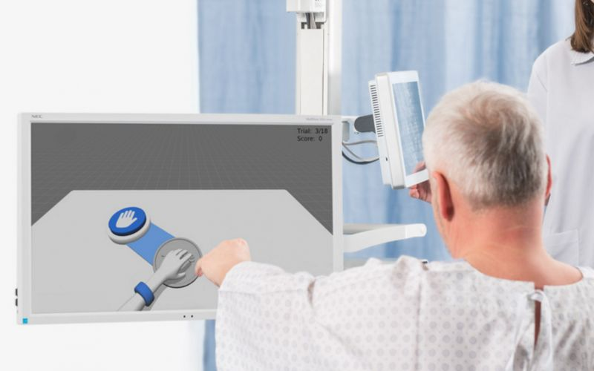
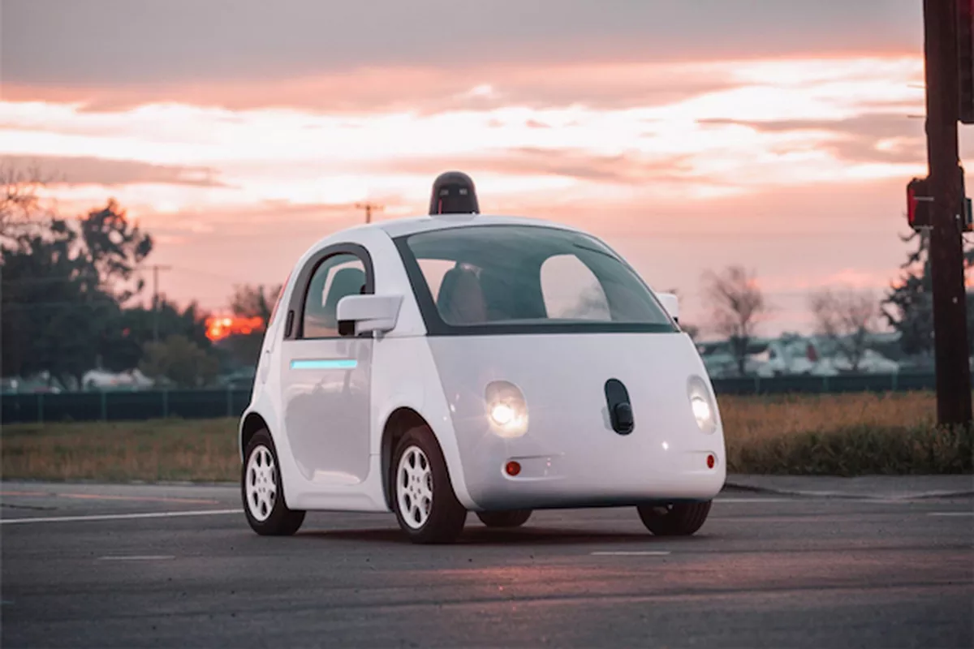
3. APPLY: Using the unified model develop applications in…
CLINICAL NEUROSCIENCE
ENGINEERING

Slide 36
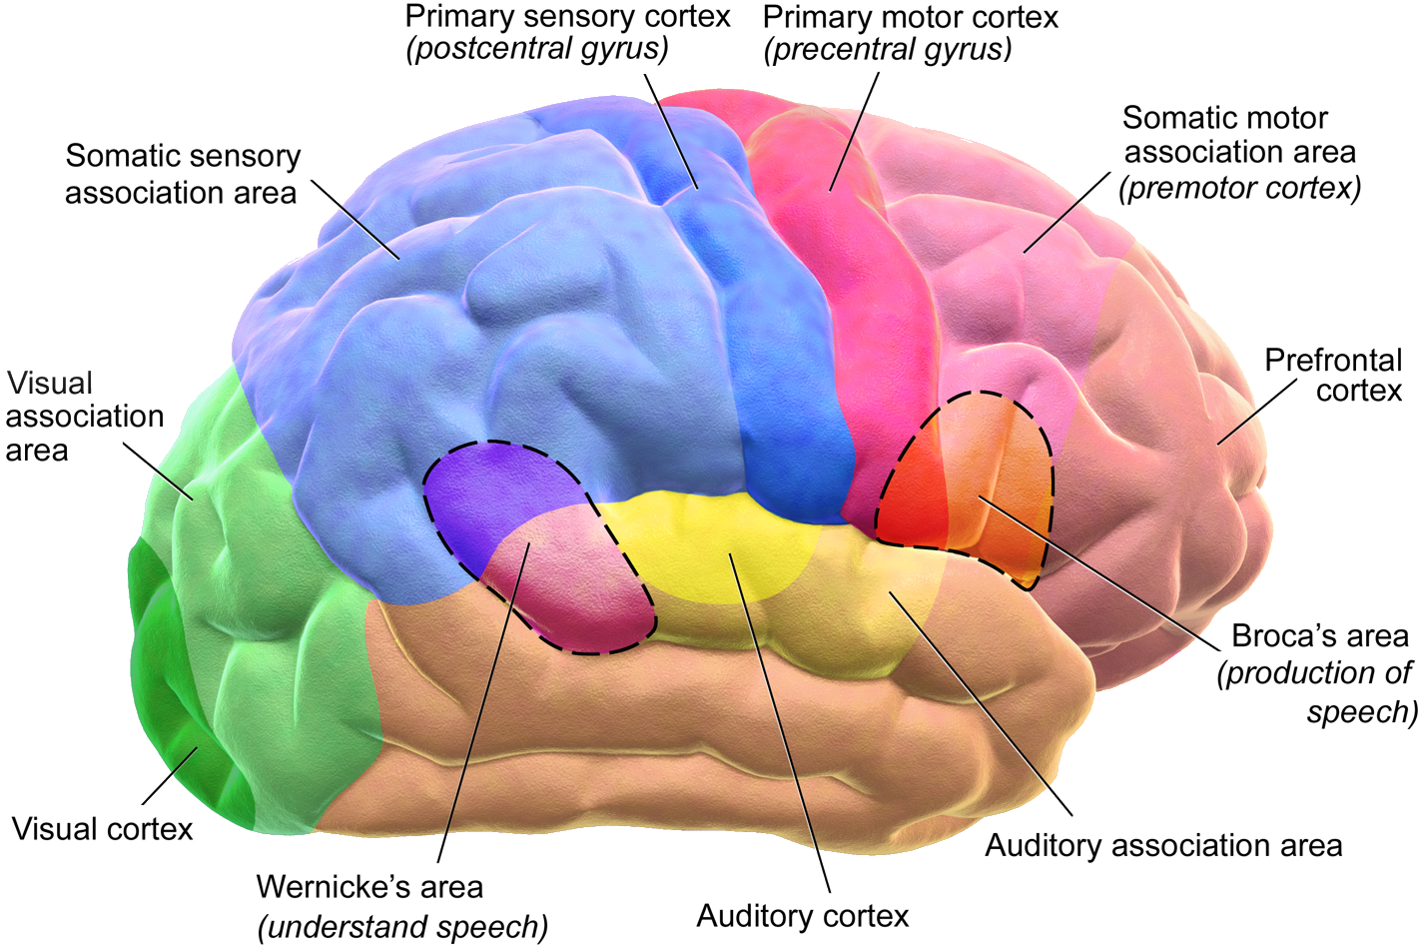
Modeling the Whole Brain
Adult human brain: 100 billion neurons
Proposed model: 10 million neurons (approx)
(Wiki)

Slide 37
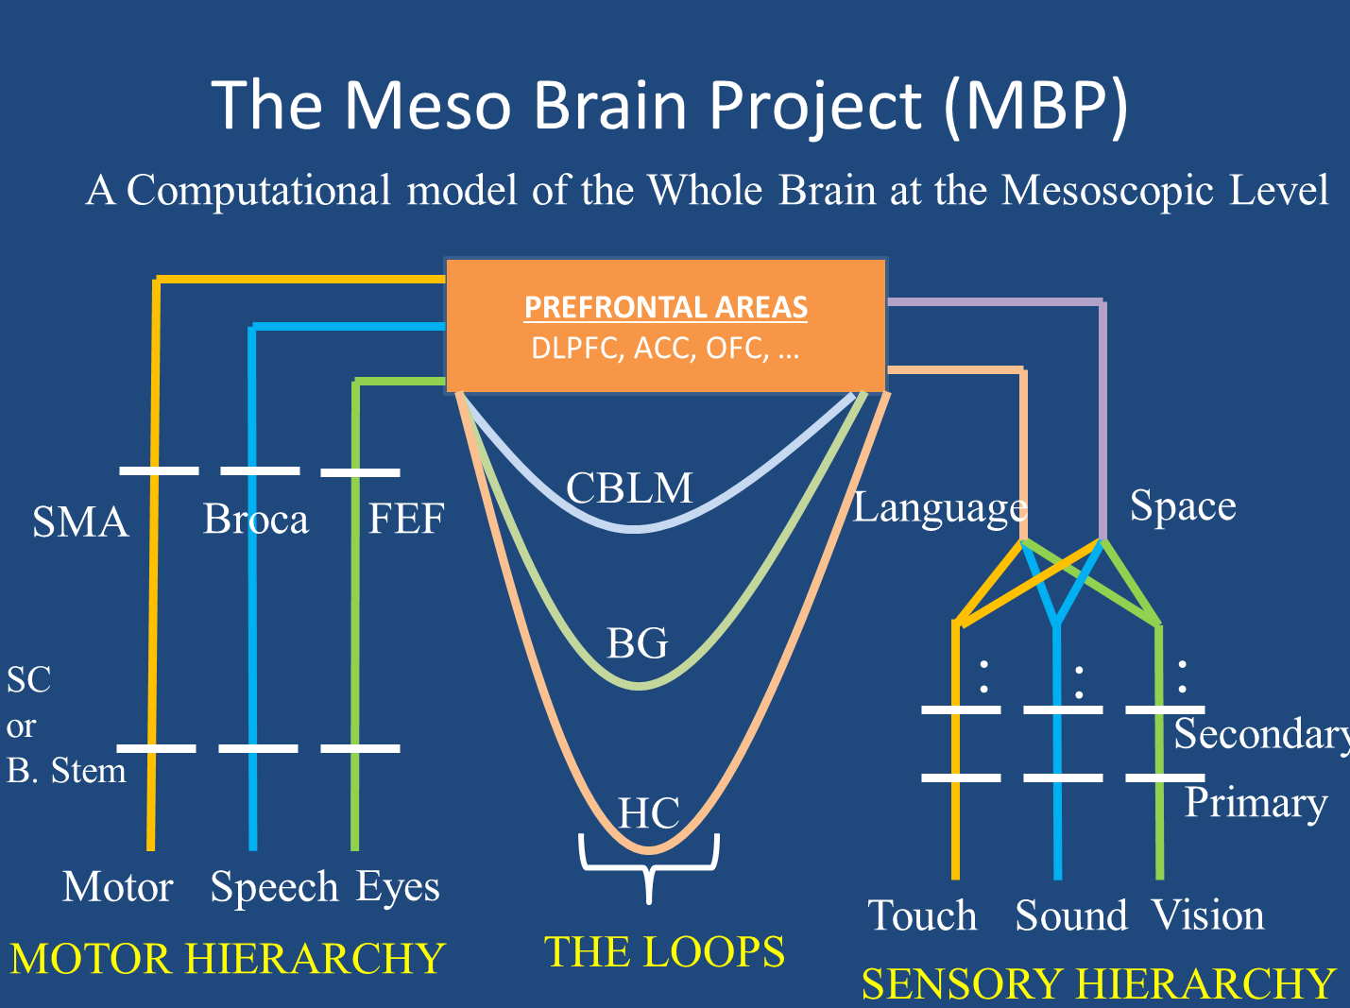

Slide 38
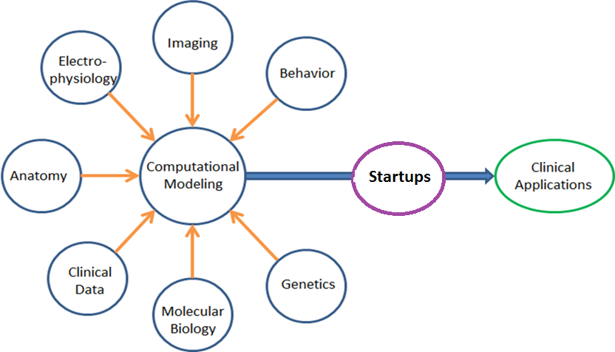
INTEGRATED APPROACH
Create interdisciplinary teams that take an ENGINEERING APPROACH To NEUROSCIENCE

Slide 39
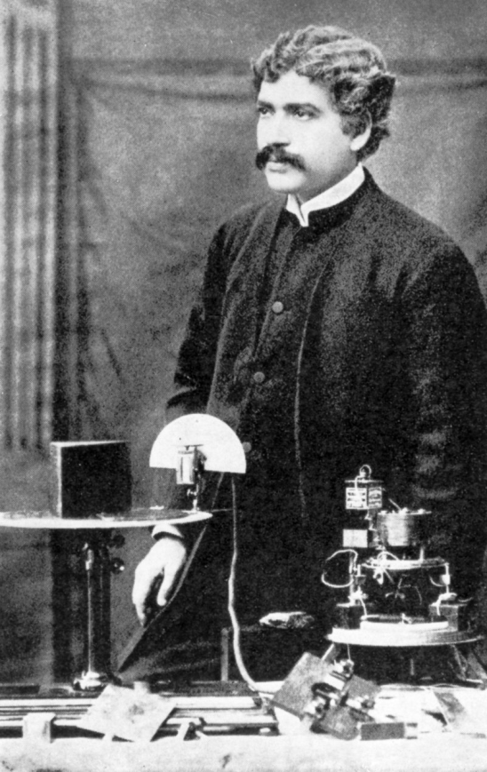
“They who behold the One,
In all the changing manifoldness
Of the universe,
Unto them belongs the eternal truth,
Unto none else, unto none else.”
JAGADIS CHANDRA BOSE
(1858-1937)

Slide 40
Table of Contents
Math preliminaries
Single neuron
Hodgkin-Huxley model
Biophysical modeling
Reduced neuron models

Slide 41
Table of Contents
Feedforward Neural Networks. Deep networks and modeling sensory function.
Hopfield neural network. Hippocampus and memory functions.
Self-Organizing Maps and brain maps

